Slide 1
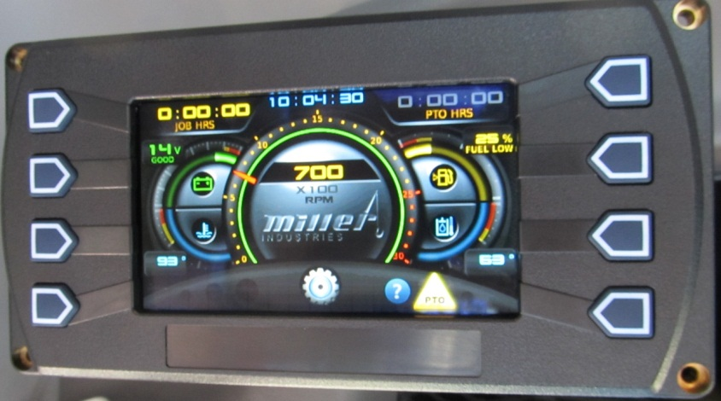
MMO/MMGO Display
Rev03
For Use with Version 25a and newer software

Slide 2
Table of Contents
3-Screen Layout Structure
4-Navigation
5-Home Screen
6-Gauge Screen
8-Menu and Settings Menu
10-User Settings
13-Day/Night Mode
14-System Settings
15-Date and Time
18-Engine Diagnostics
19-Job Timer Function
21-Report Summary
24-Service Reminders Initialization
30-Service Reminders Reset
42-Button Screen
44-Video Screen
45-Charge Cradle Warning Screen
46-PTO Warning Screen
47-Appendix
49-Wiring Diagrams
55-Specifications
56-Overview Software update instructions
57-Detailed Software update instructions
67-MMGO information
Rev 02

Slide 3
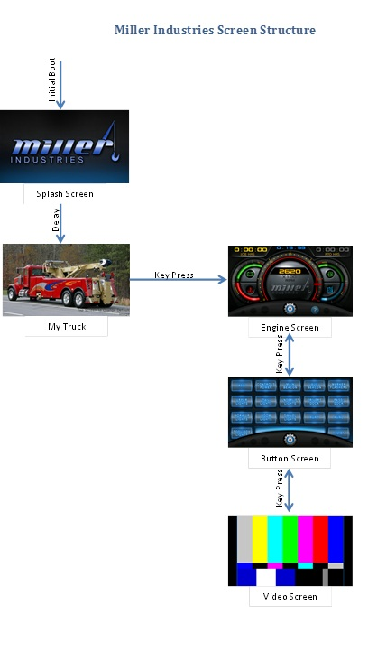
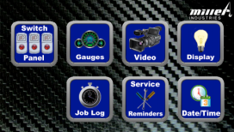
When the screen initially boots up, it will momentarily pass through a Miller splash screen and then will stop on the “My Truck Model” page or whatever page you initialized it to
Gauge Screen
Key Press
Key Press
Key Press
Home Screen
As the pages are cycled, you loop through 5 pages
Note: MMGO/Greer system adds an additional page

Slide 4
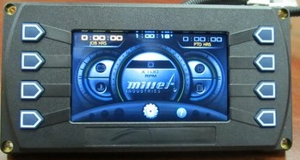
Navigation
To Home Page
Back
Forward
Use lower keys to navigate between screens or go directly to the home screen from most pages

Slide 5
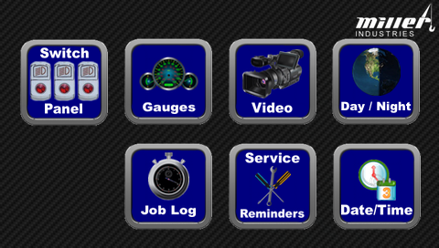
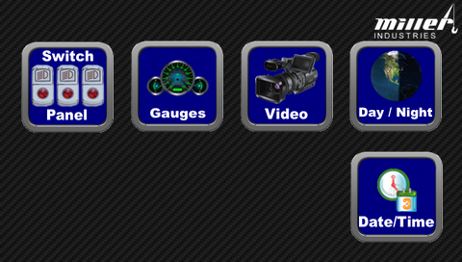
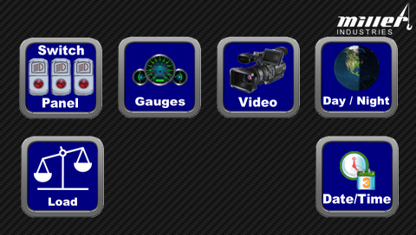
Home Screen
Toggles between a dimmer night mode with subdued color scheme
Shortcut directly to
screen
MMO/MMGO Front
Touch the appropriate button to quickly navigate directly to the screen or feature that you need.
MMO Rear
MMGO Rear

Slide 6
1-Gauge Screen
Clock
Job Timer
Battery
Voltage
Fuel Level
Chassis Engine Coolant
Temperature
Wrecker Hydraulic
Temperature
Access “Help”
Access “Settings Menu”
Engine
RPM

Slide 7
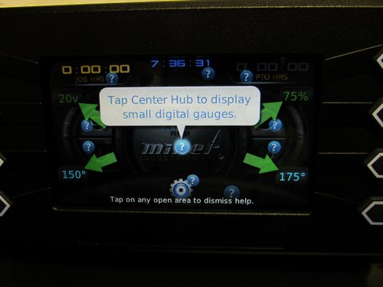
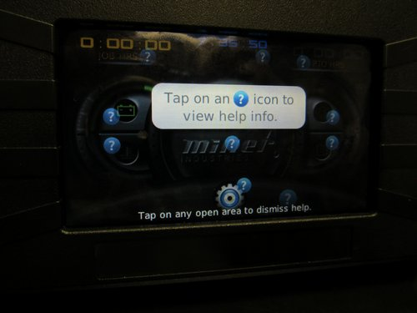
Gauge Screen Help Icons
Touch the ? “help” icons to display more information on a display feature

Slide 8
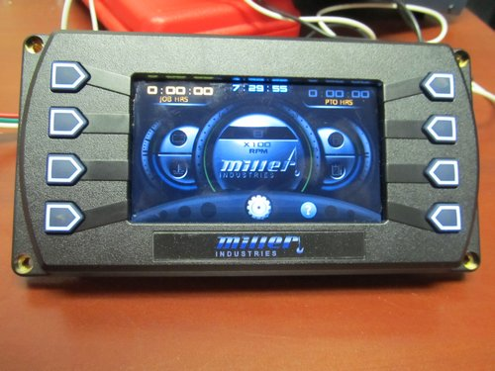
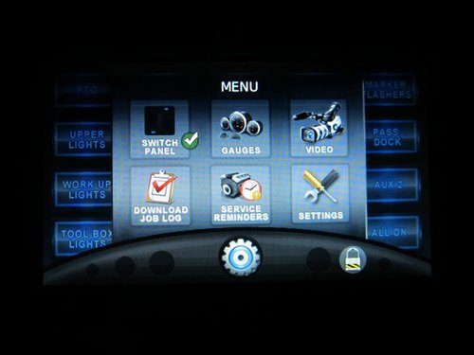
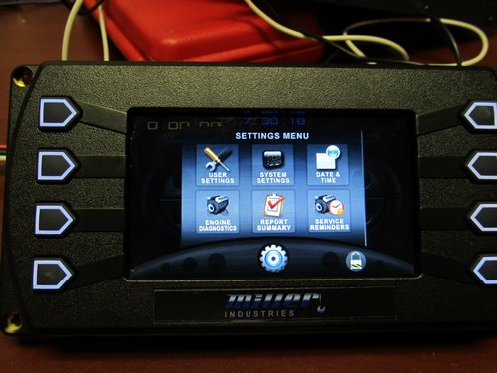
Accessing the Menu and Settings Menu
Touch the gear in the lower part of the page to get to the Menu. Touch the “Settings” button and you will get the Settings Menu. (Note: “Menu” has many of the same features as the “Home” screen). The gear is available on both the Gauges and Switches screens.

Slide 9
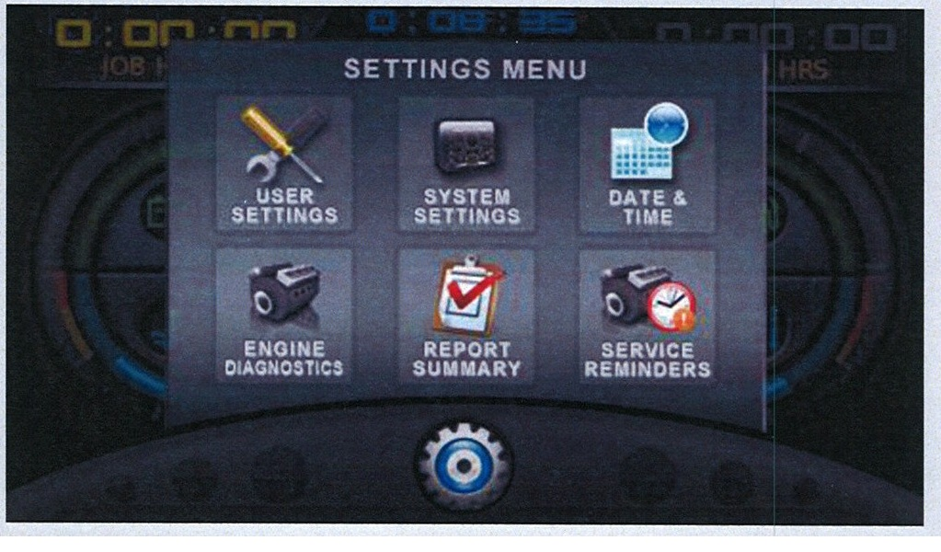
Settings Menu
(Detail)

Slide 10
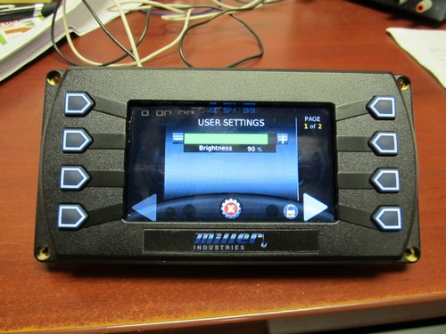
User Settings
On the Settings Menu screen, touch the “User Settings” icon. You will get the User Settings screen.

Slide 11
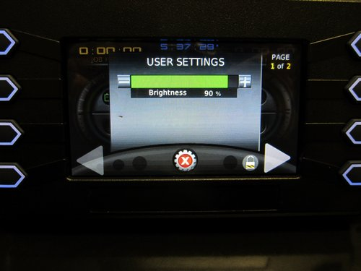
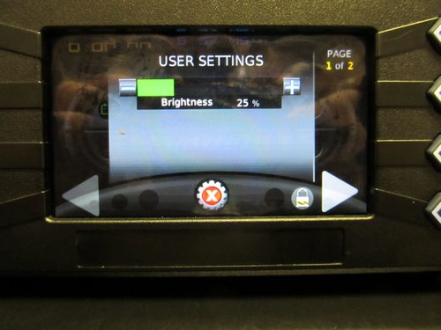
User Settings
Adjust overall screen brightness if necessary
From this screen, touch here to access the model selection page

Slide 12
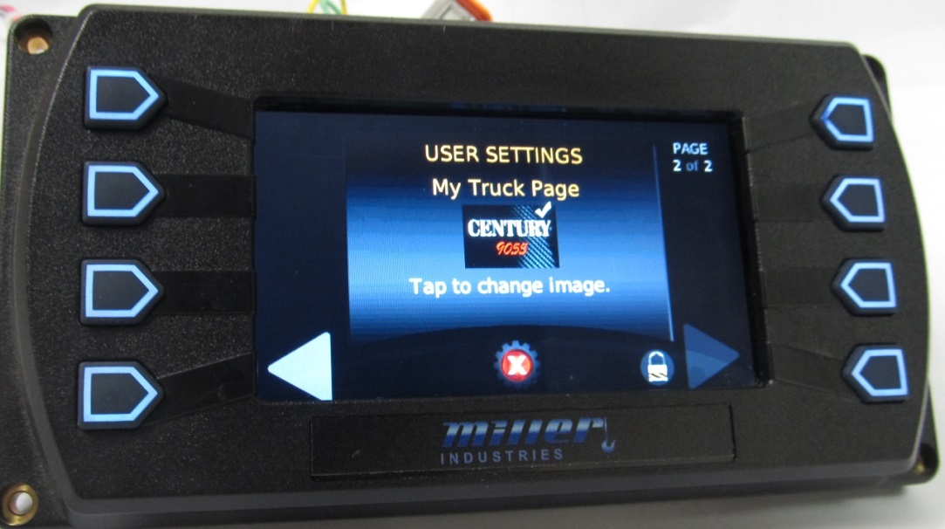
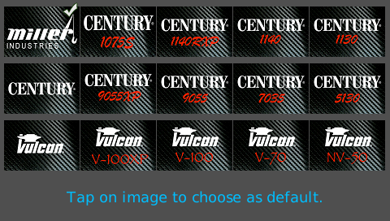
User Settings
Wrecker Model Selection-Choose the one that most closely matches your wrecker and then touch the image to select it. (front display only)

Slide 13
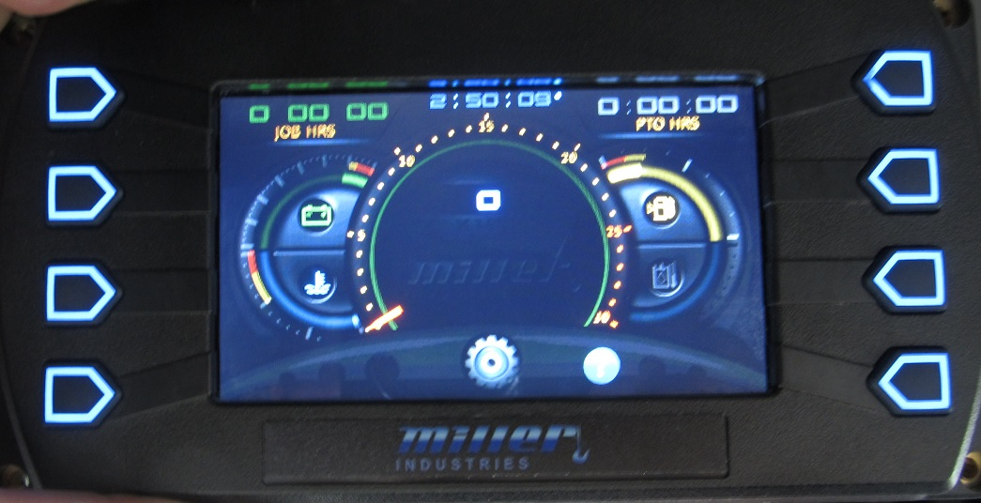
Day/Night Mode
Toggles between Day and Night color schemes
Night mode “mutes” the color scheme for less distraction. This feature is only available on the Home Screen.

Slide 14
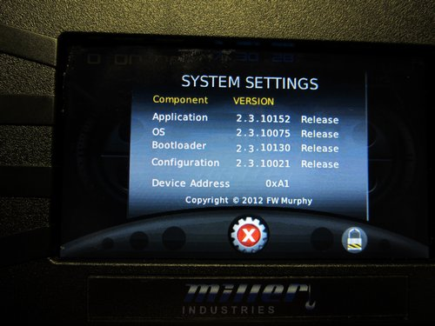
System Settings
Screen programming information. You may be asked for this in a Service situation

Slide 15
Date and Time
Date and time are password protected. You should not need to adjust these except initially

Slide 16
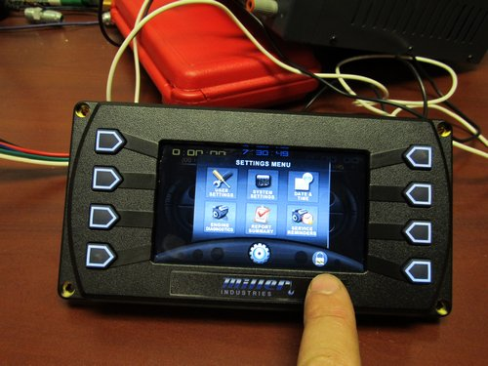
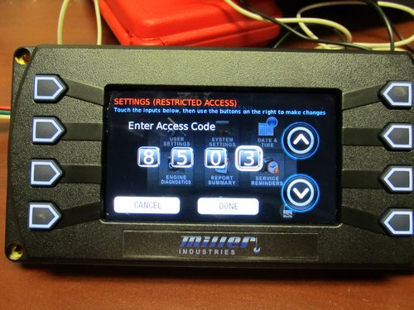
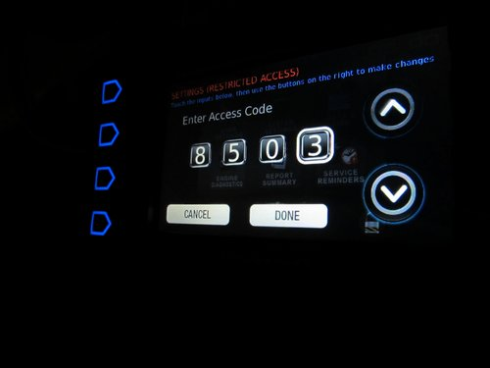
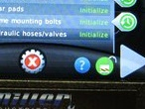
Date and Time
Password Protection
Touch the padlock and enter the access code “8503”, then “Done”. This will return you to the Settings Menu. The padlock must show unlocked to reset the Date and Time (detail right). You may then go to the Day and Time screen and make changes

Slide 17
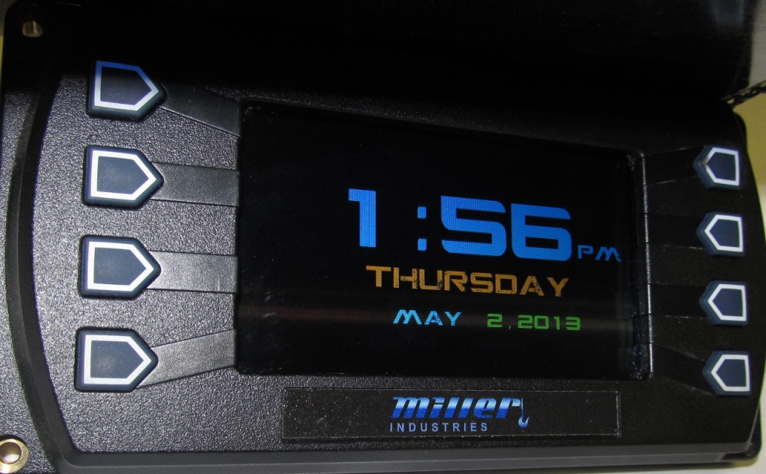
Date and Time
Displays Current day and time
Touch the screen to go back to the Home Screen.

Slide 18
Engine Diagnostics
Touch this if there is a SES lamp illuminated on the dash. Available from front display only

Slide 19
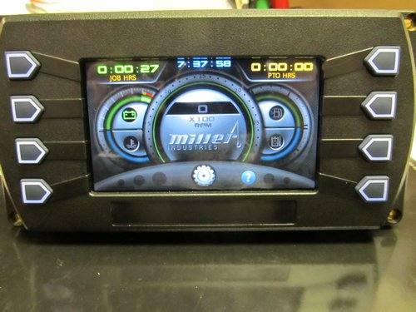
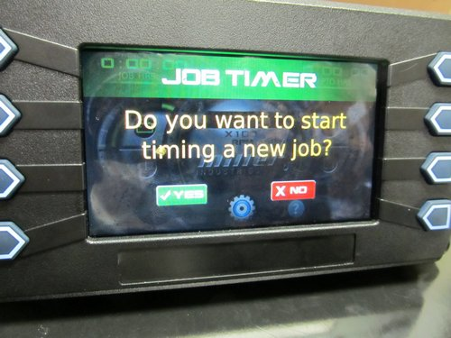
Gauge Screen Job Timer Function (Front Screen Only)
To start a new timer
2) Touch “yes”
1) Push here to start
(3)and end ) the job from either the Home or Gauge screens
When the PTO is engaged it creates a subset time log

Slide 20
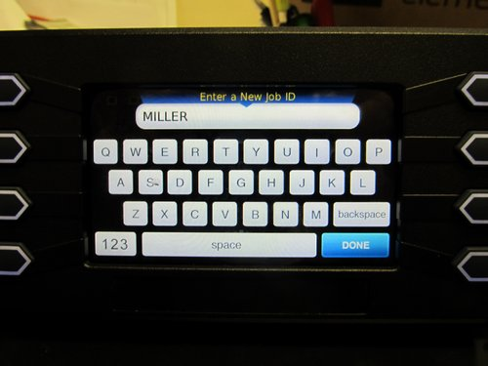
Gauge Screen Job Timer Function
(keypad)
3) Enter a Job name in the keypad and the job starts. 4) At the end of a job; touch again and you will have a record of how long you were gone, and how long the PTO was engaged to aid in billing. 5) This is downloadable onto a USB memory stick and then into a computer spreadsheet as an Excel file using the “Report Summary”.

Slide 21
Report Summary
Access through the settings menu

Slide 22
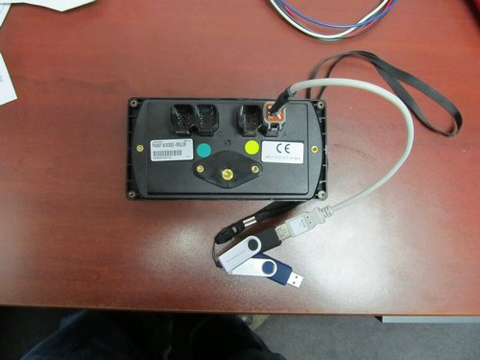
Report Summary
Allows user to export Job Timer information to a FAT32 format USB memory stick using USB cable in rear port “A”.

Slide 23
Report Summary
Sample Report Summary. Note Job name, Date, Start time, Complete Job time, PTO subset time, and fuel consumed

Slide 24
Service Reminders Initialization (Front Screen Only)
On the Settings Menu screen or on the Home Screen, touch the “Service Reminders” icon. You will get the Service screen.

Slide 25
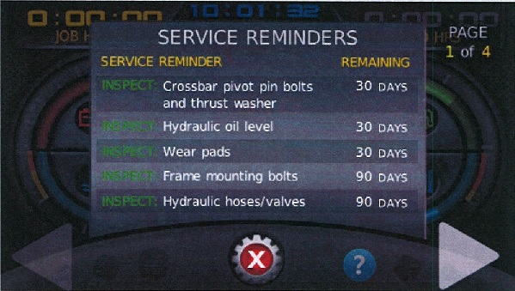
Service Reminders Initialization
“Normal” Service Reminder screen with no alarms

Slide 26
Service Reminders Initialization
Procedure to initialize them from Settings Menu:
1-Service Reminders are only available on the front display and are not initialized. You will want to initialize them before delivery.
2-Touch the padlock and enter the access code “8503”, then “Done”. This will return you to the Settings Menu. The padlock must show unlocked to initialize the Service Reminders (detail right).

Slide 27
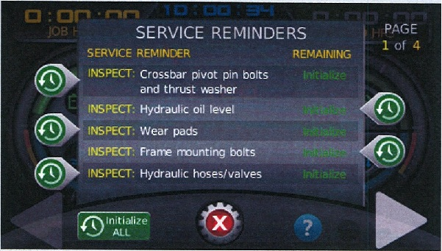
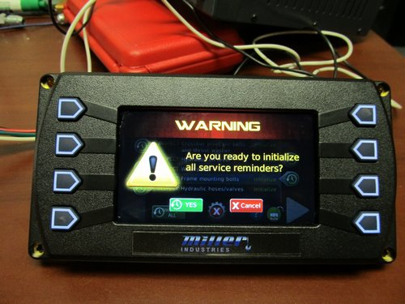
Service Reminders Initialization
Procedure to initialize them:
4-On the Service screen touch the “Initialize All” and then touch “yes”.
-If the “Initialize All” button is gone, proceed. If it is still there, repeat this step again.

Slide 28
Service Reminders Initialization
5-You will be returned to the Service screen. Note: Items can be reviewed at any time to see how much time is remaining until the reminder will pop up again.

Slide 29
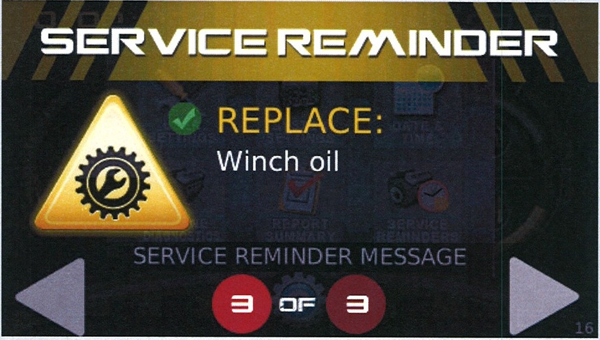
Service Reminders Initialization
“Normal” Service Reminder screen example

Slide 30
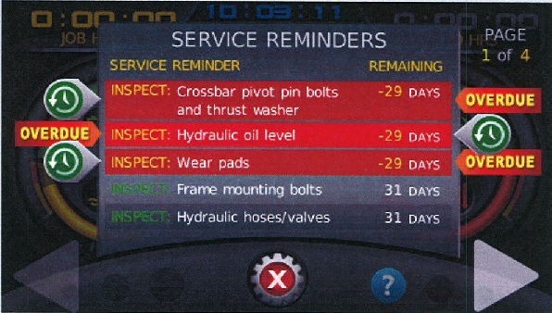
Service Reminders Reset
Service Reminder screen-reset required

Slide 31
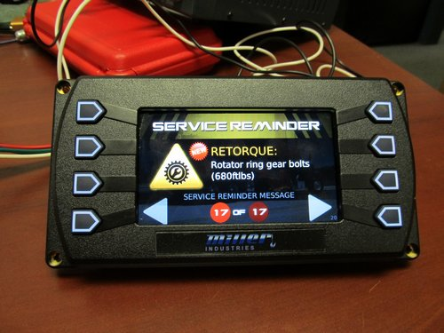
Service Reminders Reset
You will see overdue messages like this one that continue to appear on the front screen only; whenever the key is cycled. They must be reset in order that they do not continue to appear each time the key is cycled.

Slide 32
Service Reminders Reset
Each item is something that requires review in a timely fashion.
The time interval on each item has been established and is not adjustable.
Rotator-only items are grayed out and do not pop up on Integrated units.
A password code is required to reset these items so that drivers do not just overlook them.

Slide 33
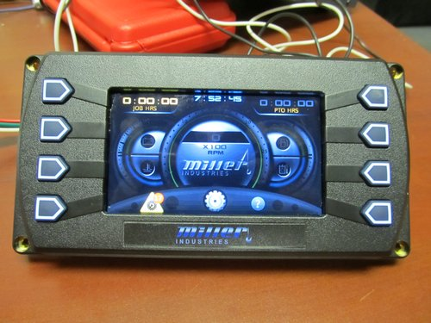
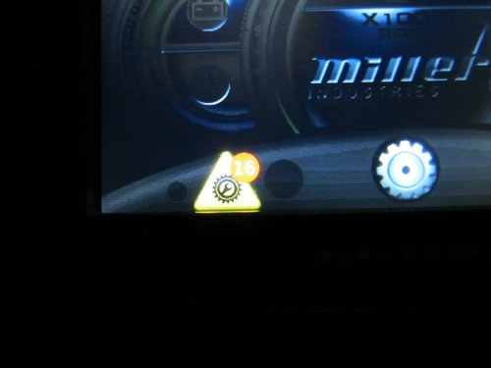
Service Reminders Reset
Until they are reset, you will have an icon in the screen corner telling you that they are there.

Slide 34
Service Reminders Reset
Procedure to reset them:
1-After you have done what the item requests (inspect, lube, replace, or retorque), go to the Information screen, touch the gear in the lower part of the page to get to the Menu. Touch “settings” button and you will get the Settings Menu. The gear is available on both the Gauges and Switches screens.

Slide 35
Service Reminders Reset
Procedure to reset them:
2-Touch the padlock and enter the access code “8503”, then “Done”. This will return you to the Settings Menu. The padlock must show unlocked to reset the Service Reminders.

Slide 36
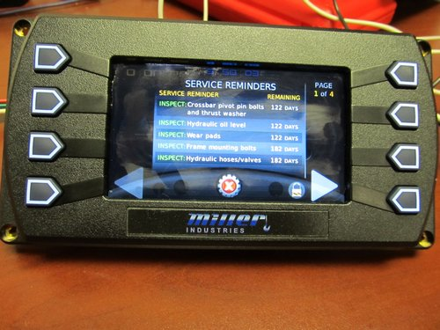
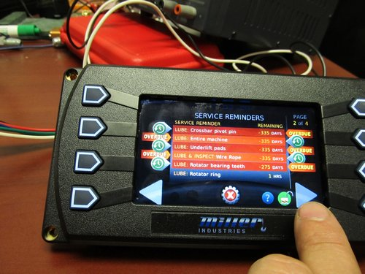
Service Reminders Reset
Note the difference in the screens when the padlock is locked and unlocked. When locked you can only view items. When unlocked you can reset them.

Slide 37
Service Reminders Reset
Procedure to reset them:
3-On the Settings Menu screen, touch the “Service Reminders” icon. You will get a Service screen. There are 4 pages of maintenance items, you can toggle through the pages using the lower touch arrows.

Slide 38
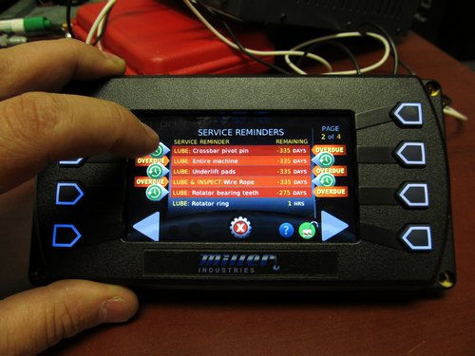
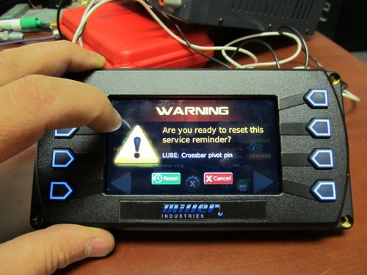
Service Reminders Reset
Procedure to reset them:
4-Each item must be reset separately. To reset each one, touch the green icon to side (could be either left or right) of each overdue item. You will then go to a side screen and touch the reset button each time.

Slide 39
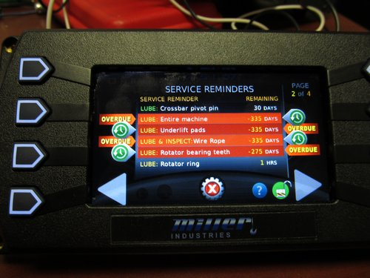
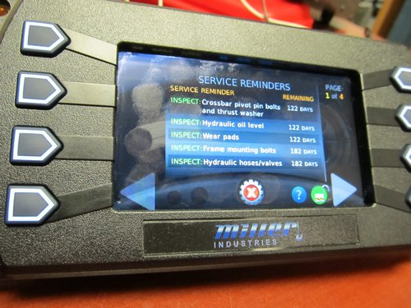
Service Reminders Reset
Before item reset
After item reset
Procedure to reset them:
5-You will repeat for each overdue item on each page. When done, touch the gear again and you will be taken back to the Settings Menu page.

Slide 40
Service Reminders Reset
Procedure to reset them:
6- On the Settings Menu screen touch the gear in the lower part of the page twice to go back to the Information screen and you can resume normal operation of the wrecker. If all messages are cleared, there will not be a reminder icon in the bottom of the screen.

Slide 41
Service Reminders Reset
Items can be reviewed at any time to see how much time is remaining until the message will pop up again.

Slide 42
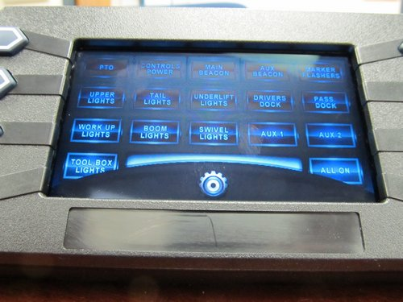
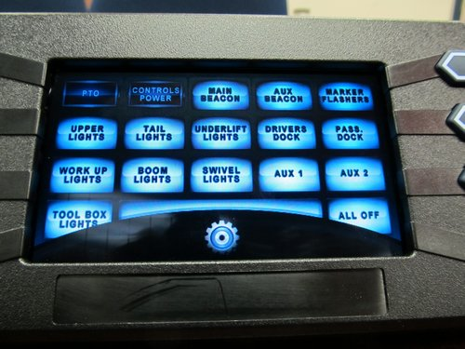
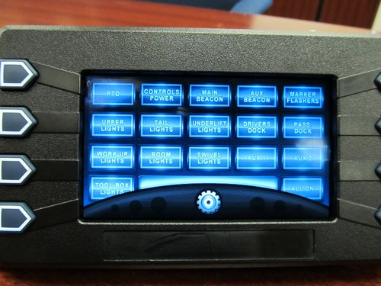
2-Button Touch Screen
Shortcut from the Home Screen

Slide 43
Button Touch Screen
-Touch individual buttons to turn features on or off.
-Features may be turned on at one of the screens and turned off at the other if desired.
-PTO may not be turned on from the rear, but may be turned off (except automatic transmission).
-”All On” button in lower right corner turns all lights on with one touch. PTO and Controls are not affected and must be individually controlled.
-”All Off” is similar to “All On” but in reverse.

Slide 44
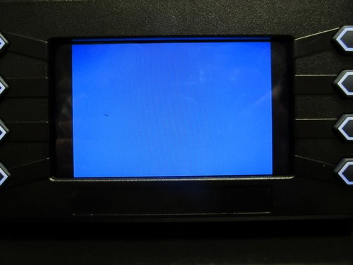
3-Video Screen
Can be accessed from the Home Screen
-See Appendix for wiring information.
-Note: Video is only displayed on the screen it is input into, not both

Slide 45
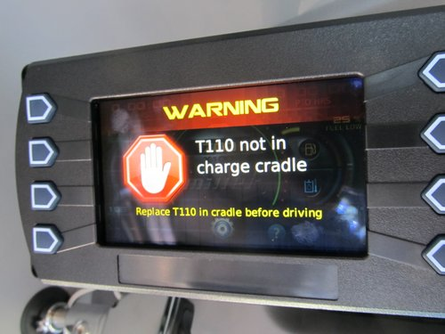
Charge Cradle Screen
Front display will show this message if the T110 remote is out of the charging cradle. It will not allow any other interaction with the front display until the remote is returned.

Slide 46
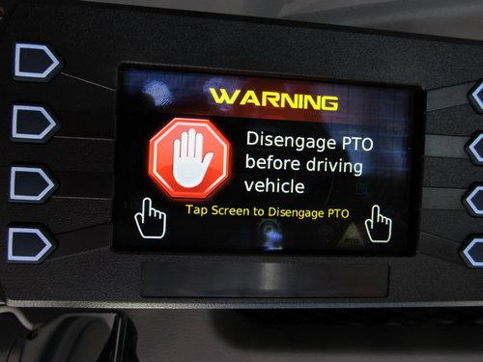
PTO Warning Screen
Front display will show this message if the PTO is engaged. It will not allow any other interaction with the front display until the PTO is turned off. Touch the Hand Sign to disengage the PTO.

Slide 47
Additional information Appendix

Slide 48
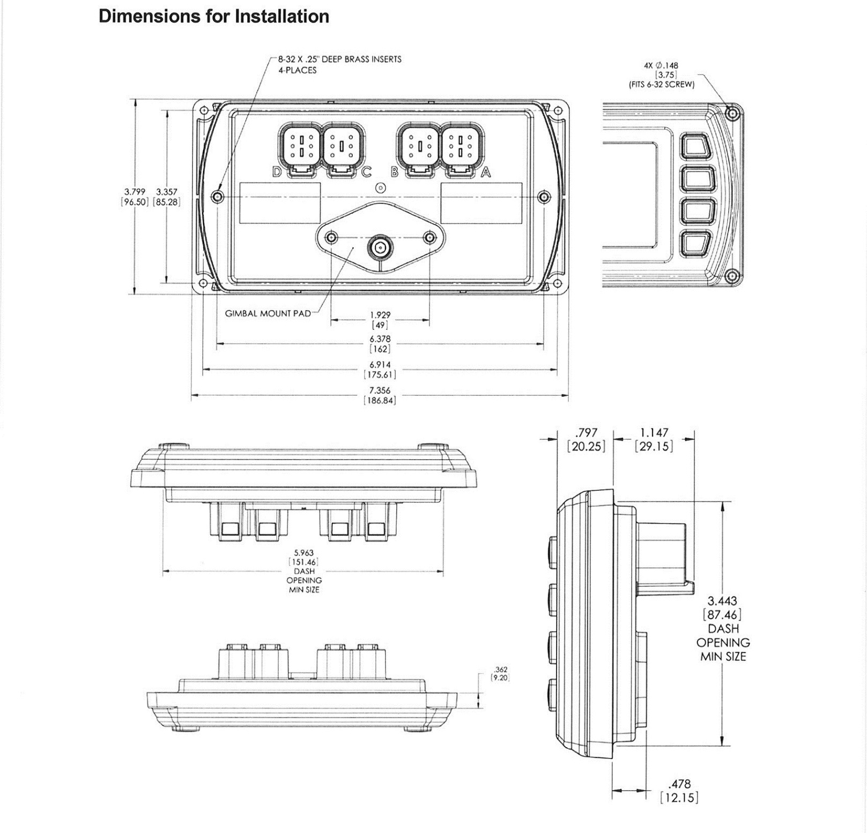

Slide 54
Flasher Relay Wiring (using VCAN wiring)

Slide 57
MMO Software Update
Procedure to update screen software:
1-Start with the front display. Plug the white USB cable into port “A”. A 0311677 USB cable (above right) is provided with every unit. If you do not have one, contact Customer Service.
2-Then plug memory stick into cable.
Notes: 1-Cable label incorrectly says port “C”, must use “A”.
2-wiring removed from port “B” for clarity.

Slide 58
MMO Software Update
Procedure to update screen software:
-3-Hold down upper left button with 1 hand. Turn on the ignition with the other. (Note: this works well on a front screen. On a rear screen you can either use an assistant; or just unplug, hold down the button, and re-plug connector “B” to cycle the power)
-You will see a black screen with the word “Booting….” in the upper left corner. Release the upper left button.

Slide 59
MMO Software Update
All front; rear MMO
Rear MMGO Only
On the front screen and the rear MMO screen, the background will be black. On a rear MMGO screen only, the background will be white.
If you see a “regular” screen, you were not holding the button down when the power cycled. Repeat step 3.

Slide 60
MMO Software Update
If you see this screen, you either do not have the USB cable or the memory stick properly installed (or the stick is not FAT32 format). Repeat from step 1 if this is the case. (Note: this screen may also be seen if a button is held down during power cycling)

Slide 61
MMO Software Update
Procedure to update screen software:
-4-using the middle buttons on the right side, select the appropriate update.

Slide 62
MMO Software Update
(twice)
Procedure to update screen software:
-5-push the lower right button twice. The screen will begin updating. On a rear MMGO display after it reboots you are done. On any front or a rear MMO, continue.

Slide 63
MMO Software Update
Procedure to update screen software:
-6-After it reboots, it will ask if this is a front display. Choose the appropriate response. It will reboot again.

Slide 64
MMO Software Update
Procedure to update screen software:
-7(rear)-After it reboots as a rear, it will ask if the vehicle has an automatic transmission. Choose the appropriate response. If so, it will allow the PTO to be turned on from the rear.

Slide 65
MMO Software Update
Procedure to update screen software:
-7(front)-After it reboots as a front, it will ask if this is a Rotator. Choose the appropriate response. This establishes the correct Service reminders.

Slide 66
MMO Software Update
Procedure to update screen software:
-8-After it reboots, it will allow you to choose a default screen for each time it starts. This may be different for front and rear. Choices are “Home”, “Gauges” and “Switch Panel”.

Slide 67
Greer MMGO System (2012-2013)
Boom Extension (from pin)
Allowable Load
Elevation Angle
Parts of Line
Radius from Center (for charts)
Load on Boom
Rotational Angle
2 touch screens are standard with an MMO and MMGO system. But only the rear display shows load information with the optional MMGO system.

Slide 68
GS MMGO System (2013-Present)
Boom Extension (from pin)
Rotational Angle
Elevation Angle
% Capacity
Actual/Capacity
Parts of Line
Allowable Load
Load on Boom
Wrecker
Model
Radius from Center (for charts)
2 touch screens are standard with an MMO and MMGO system. But only the rear display shows load information with the optional MMGO system.

Slide 69
GS MMGO System-Level (mid 2014-present)
This page allows you to level your truck using the boom sensor located in the turret. The boom must be rotated to the rear (stowed position) for the system to be accurate.
Truck is level:
Green bubble,
no action required
Truck is high in rear:
Either lower the rear or raise the front as appropriate
Truck is high on Right side:
Either lower the right or raise the left as appropriate

